Slide 1
Analysis and design of algorithms
Name:Farah tarek Id:220793

Slide 2
Table of contents
01
02
03
05
04
06
Partitioning algorithms
Decrease and conquer
Hoare partitioning algorithm
What is decrease and conquer?
Why we use partitioning ?
How is Hoare partitioning done?
Coding wise
Code explanation
Code analysis
Code representation for Hoare’s algorithm
Explanation of code representation of hoare’s algorithm
Analysis of code representation of hoare’s algorithm

Slide 3
01
Decrease and conquer
What is decrease and conquer?

Slide 4
What is Decrease and conquer?
1st Decrease
2nd Conquer
Reduce the size of the problem by solving a simpler or smaller instance of the same problem.
Solve the smaller instance of the problem.
3rd Combine
The solutions to the smaller subproblems are combined to obtain the solution to the original problem.

Slide 5
02
partitioning algorithm
Why we use partitioning?

Slide 6
Why we use partitioning algorithm
The core idea behind partitioning involves dividing the input into smaller sets, addressing each subset individually, and subsequently merging the outcomes to obtain the complete solution.

Slide 7
03
Hoare’s partitioning algorithm
How is Hoar partionong algorithm is done?

Slide 8
Hoars partitioning algorithm (Two directional scan)
is a partitioning algorithm is used to partition an array about a pivot ,In a way that all elements smaller that the pivot are on its left (in any order) and all elements greater than the pivot are on its right (in any order) .

Slide 9
Start from Both Ends: The algorithm starts with two pointers, often called left and right markers, positioned at the two ends of the array , and pivot choice.
R
3 | 4 | 9 | 1 | 7 | 0 | 5 | 2 | 6 | 8
P
I
V
O
t
L
1.Choose 3 as a pivot.
2. Choose 4 as L (1st element in array)
3.Choose 8 as R(last element in array)

Slide 10
Move towards each other: The left marker moves from the leftmost end towards the right, and the right marker moves from the rightmost end towards the left
R
3 | 4 | 9 | 1 | 7 | 0 | 5 | 2 | 6 | 8
P
I
V
O
t
L
L moves to right until it finds an element greater that or equal to pivot (3)
R moves to the left until it finds an element less that or equal to the pivot (3)

Slide 11
Swap Elements: When both markers have paused, they exchange the elements they are pointing to. The left marker now has a smaller element, and the right marker has a greater element.
R
3 | 2 | 9 | 1 | 7 | 0 | 5 | 4 | 6 | 8
P
I
V
O
t
L
Swap L position with R position

Slide 12
Continue Moving: After the swap, both markers continue moving towards each other.
R
3 | 2 | 9 | 1 | 7 | 0 | 5 | 4 | 6 | 8
P
I
V
O
t
L
L moves to right until it finds an element greater that or equal to pivot (3)
R moves to the left until it finds an element less that or equal to the pivot (3)

Slide 13
Swap Elements: When both markers have paused, they exchange the elements they are pointing to. The left marker now has a smaller element, and the right marker has a greater element.
R
3 | 2 | 0 | 1 | 7 | 9 | 5 | 4 | 6 | 8
P
I
V
O
t
L
Swap L position with R position

Slide 14
Move Towards Each Other: The left marker moves from the leftmost end towards the right, and the right marker moves from the rightmost end towards the left
R
3 | 2 | 0 | 1 | 7 | 9 | 5 | 4 | 6 | 8
P
I
V
O
t
L
L moves to right until it finds an element greater that or equal to pivot (3)
R moves to the left until it finds an element less that or equal to the pivot (3)

Slide 15
Move Towards Each Other:
R
3 | 2 | 0 | 1 | 7 | 9 | 5 | 4 | 6 | 8
Note: this means that L pointer and R pointer have crossed each other which means that L is greater than
or equal R. So R position is
swapped with pivot position.
P
I
V
O
t
L
R
1 | 2 | 0 | 3 | 7 | 9 | 5 | 4 | 6 | 8
P
L

Slide 16
04
Coding wise for Hoare’s partitioning algorithm
Code representation for Hoare’s algorithm

Slide 17
Pseudocode implementing Hoare partioning algorithm
ALGORITHM HoarePartition(A[l..r])
//Partitions a subarray by Hoare’s algorithm,
// using the first element as a pivot
//Input: Subarray of array A[0..n − 1], defined by its left and right
// indices l and r (l < r)
//Output: Partition of A[l..r], with the split position returned as
// this function’s value
p ← A[l]
i ← l; j ← r + 1
repeat
repeat i ← i + 1 until A[i] ≥ p
repeat j ← j − 1 until A[j ] ≤ p
swap(A[i], A[j ])
until i ≥ j
swap(A[i], A[j ]) //undo last swap when i ≥ j
swap(A[l], A[j ])
return j

Slide 18
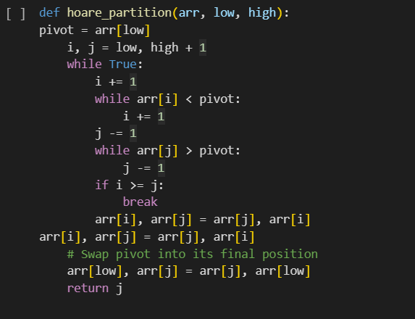
Python code implementing Hoare partioning algorithm

Slide 19
05
Code explanation
Hoare’s algorithm

Slide 20
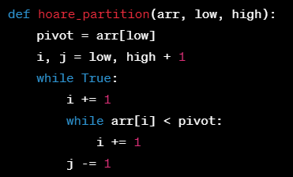
pivot = arr[low]: Selects the pivot element from the array. In Hoare's partitioning, the pivot is chosen as the first element of the subarray.
i, j = low, high + 1: Initializes two pointers, i and j, where i moves from left to right and j moves from right to left.
while True:: Initiates an infinite loop to continue the partitioning process until the pointers i and j meet.
i += 1 and while arr[i] < pivot: i += 1: Increments i until an element greater than or equal to the pivot is found.
j -= 1 and while arr[j] > pivot: j -= 1: Decrements j until an element less than or equal to the pivot is found.

Slide 21
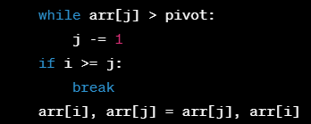
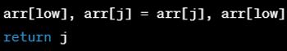
if i >= j: break: Checks if the pointers have crossed each other. If so, breaks out of the loop.
arr[i], arr[j] = arr[j], arr[i]: Swaps the elements at positions i and j to maintain the partition.
arr[low], arr[j] = arr[j], arr[low]: Swaps the pivot element with the element at position j to place the pivot in its final sorted position.
return j: Returns the index j, which represents the position of the pivot in the sorted array.

Slide 22
06
Code analysis
Time complexity analysis of Hore’s portioning algorithm

Slide 23

Time complexity
Assuming i and j will meet at x, the time complexity should be
T(n)=$\sum_{i=l+1}^{x}{1}+\sum_{j=x}^{r}{1}$
T(n)= x-(l+1)+1) +(r-x+1)
=(x - l)+(r-x+1)=r-l+1
So it will be O(n) in terms of Big O notation

Slide 24
Thanks!

